Slide 1
pROJECT 4
James Mutry
30 JUL 2024
CMSC 315

Slide 2
Uml dIAGRAM

Slide 3
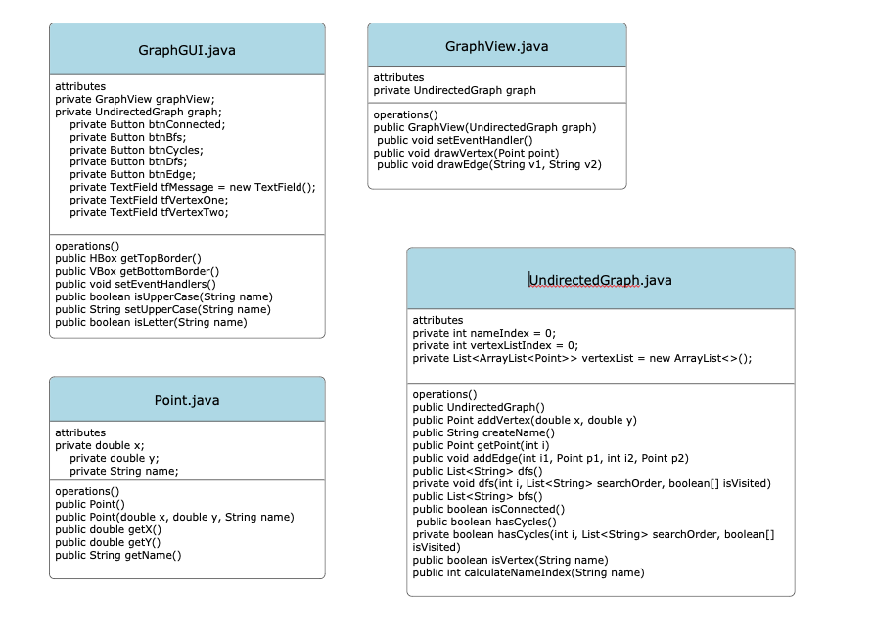

Slide 4
Testing

Slide 5
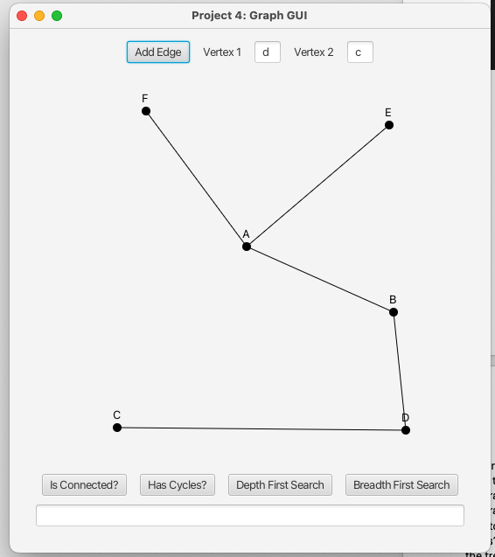
Adding Points and Edges

Slide 6
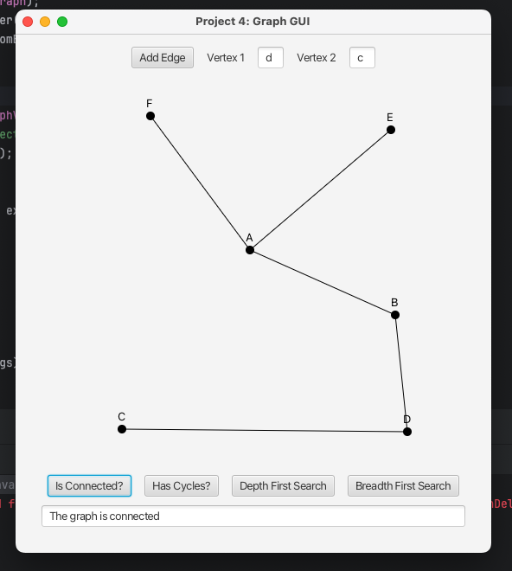
Is Connected?

Slide 7
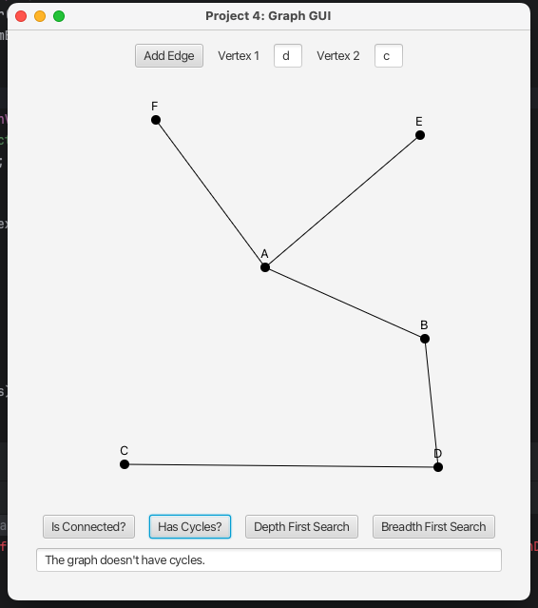
Has Cycles?

Slide 8
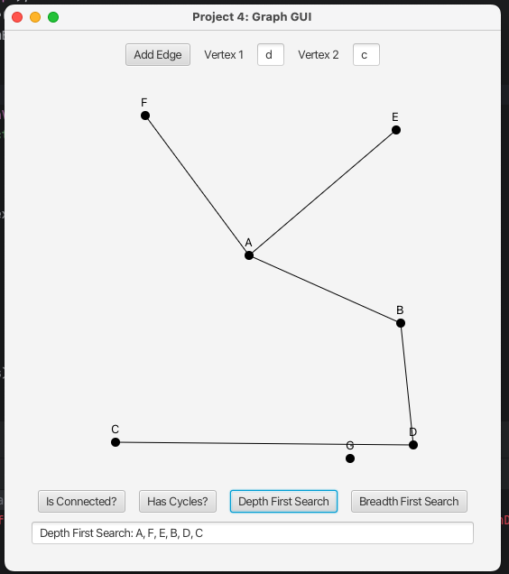
Depth First Search

Slide 9
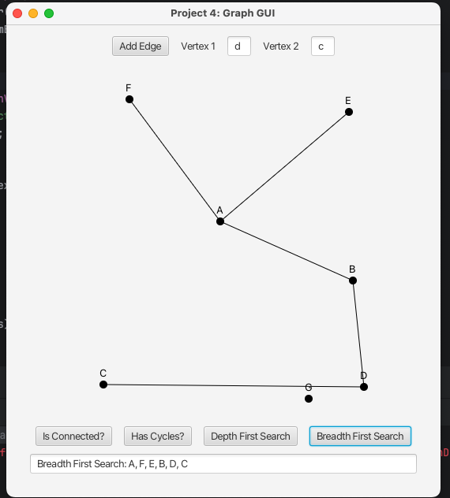
Breadth First Search

Slide 10
Lessons learned
The main lesson learned during this project was about the breadth first search. During a breadth first search the algorithm is started at the root node and searches deep to the last branch before backtracking. The main positive of a breadth first search is that it finds the shortest path to its destination.

